Slide 1
Underwater Depth Mapping through Sonar Technology
A.D.D.U. Kumara
SCT/19/047
Science and Technology
Uva Wellassa University

Slide 2
Overview
Introduction
Research Problem
Aims
Objectives
Parts of Drone
Methodology
Time Frame
References

Slide 3
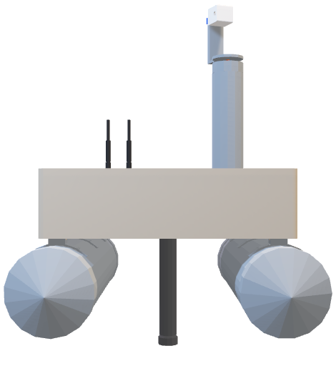
Introduction
This research aims to visualize underwater landscapes and weather patterns through sensor technology. The primary objective is to generate MATLAB 3D maps of underwater terrains by GPS coordinates with sonar depth measurements.

Slide 4
Research Problem
Underwater mapping lacks precision due to the separate handling of sonar technology and weather data. This project aims to integrate sonar depth measurements with real-time weather data, enhancing accuracy in understanding underwater terrains.

Slide 5
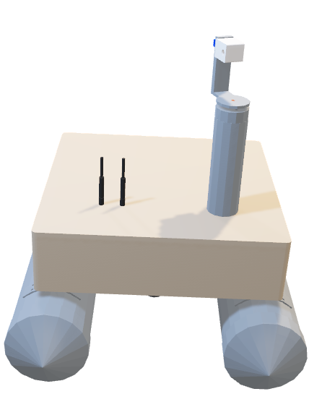
Aims
Develop an integrated system for underwater mapping merging sonar depth measurements, real-time weather data, and remote control (RC) functionality.

Slide 6
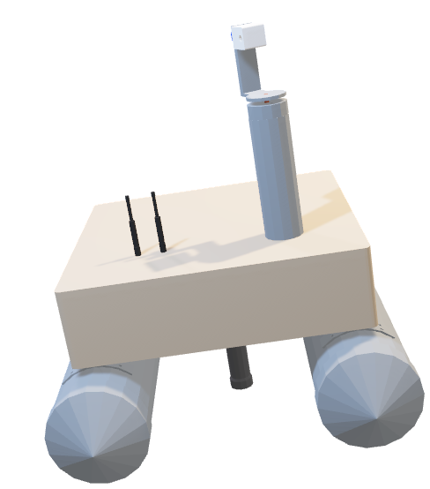
Objectives
Create a precision-driven system combining sonar, weather data, and RC capabilities for enhanced control.
Integrate RC transmitter and receiver for autonomous and manual navigation modes.
Design and implement a flight computer for improved system control and stability during mapping expeditions.
Enable comprehensive data collection and real-time control for efficient underwater mapping operations.

Slide 7
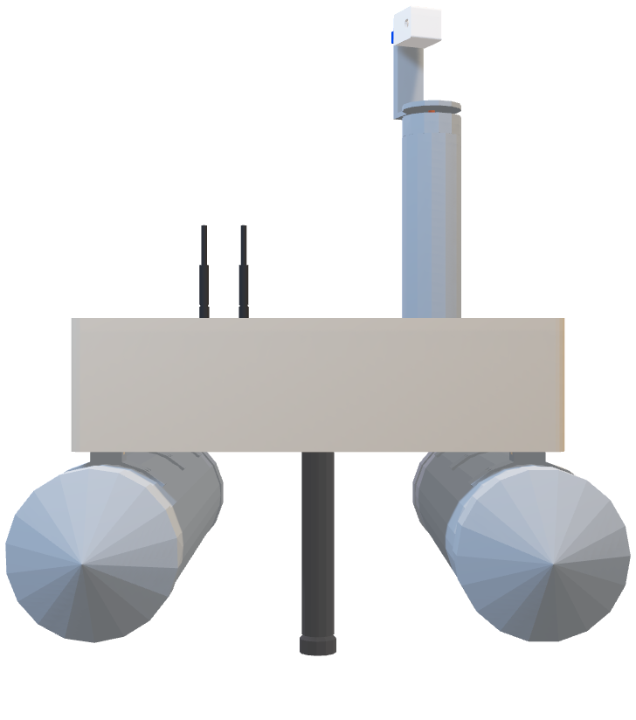
Parts Of Drone
Base of Drone
Supporting Bars
Sonar Sensor

Slide 8
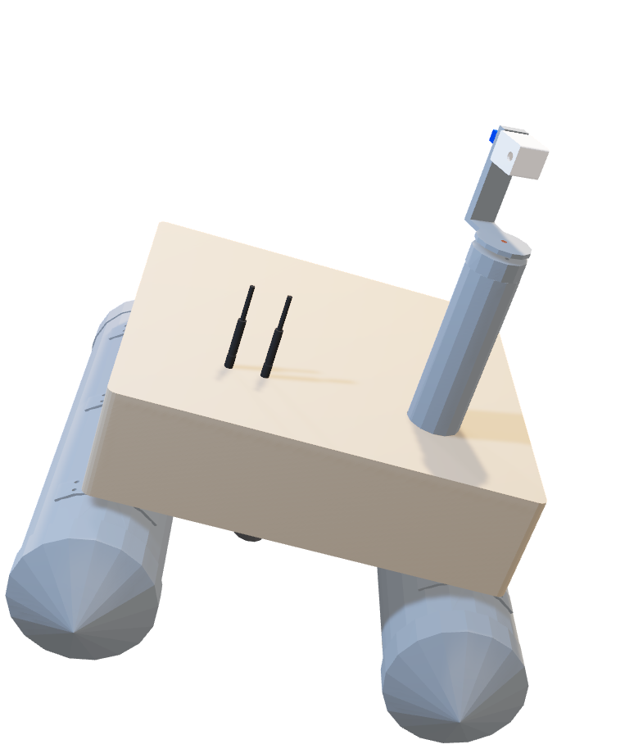
Parts Of Drone
Other Sensors
and
Antennas
2 Axis Camera

Slide 9
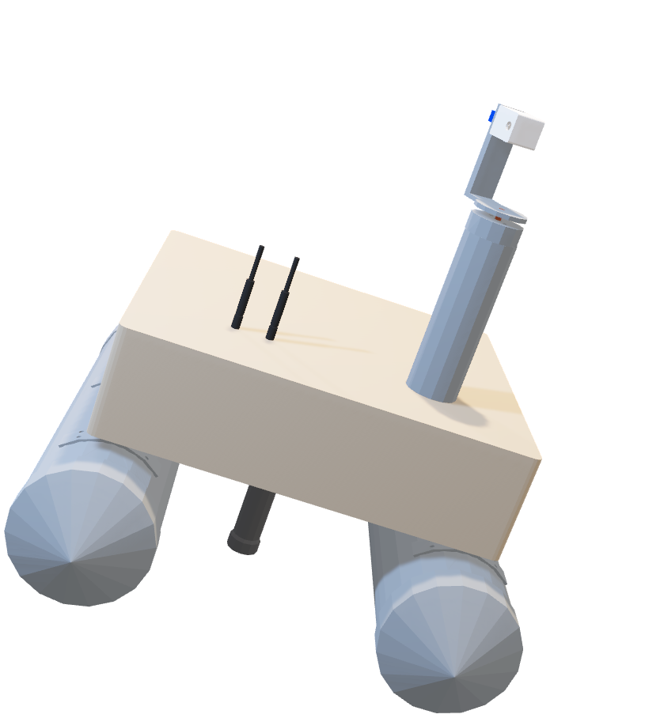
Methodology
Make drone body basic structure
Metal
ABS/PLA
PVC

Slide 10
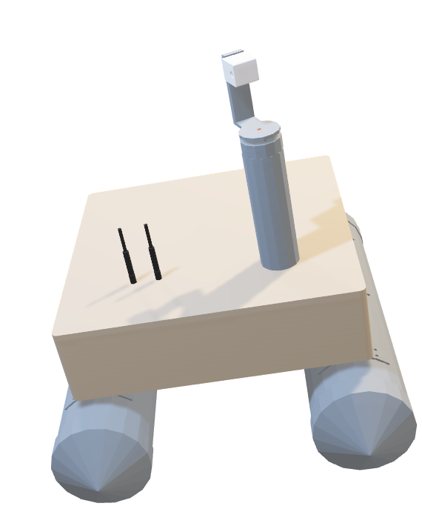
Methodology
Make drone body basic structure
Make weather data collection unit
Data collecting unit can collect
1.Air temperature
2.Air pressure
3.Humidity
4.Water Temperature
5.Altitude

Slide 11
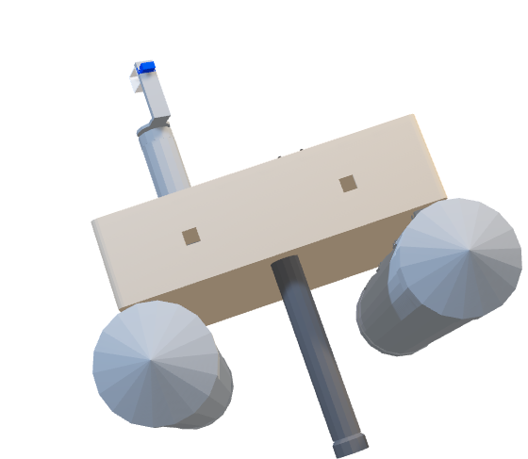
Methodology
Make drone body basic structure
Make weather data collection unit
Make depth measurement unit
Sonar sensor

Slide 12
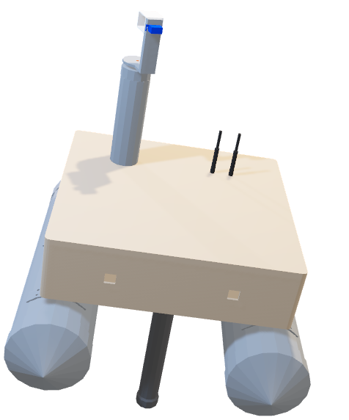
Methodology
Make drone body basic structure
Make weather data collection unit
Make depth measurement unit
Communication antennas
Make data Transmit & Receiver unit
Transmit data to ground station using 2.4GHz RC and GPRS signals

Slide 13
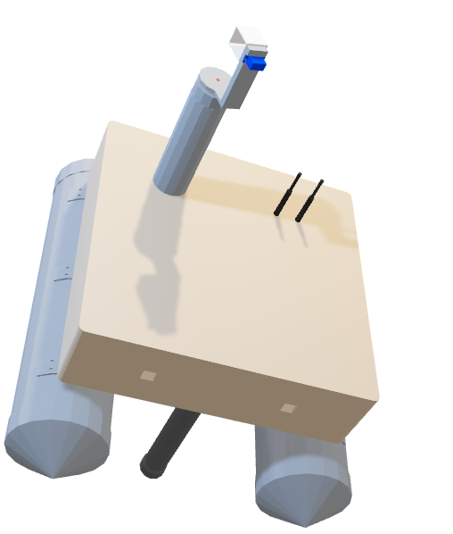
Methodology
Make drone body basic structure
Make weather data collection unit
Make depth measurement unit
Develop software side and make phototype drone
Make data Transmit & receiver unit

Slide 14
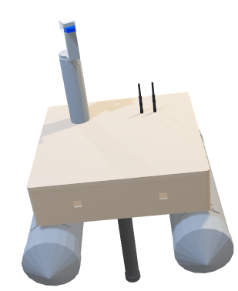
Methodology
Make drone body basic structure
Make weather data collection unit
Make depth measurement unit
Make PCB & finalize project
Develop software side and make phototype of drone
Make data Transmit & receiver unit

Slide 15
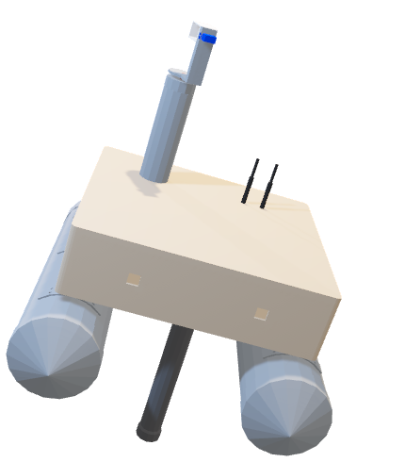
Methodology
Make drone body basic structure
Make weather data collection unit
Make depth measurement unit
Make PCB & finalize project
Develop software side and make phototype of drone
Make data Transmit & receiver unit
Testing and debug drone

Slide 16
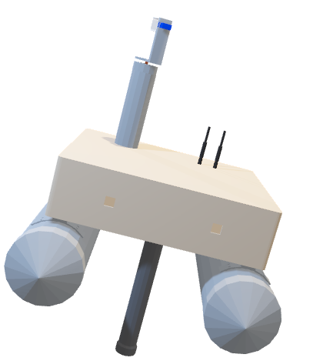
Methodology
Make drone body basic structure
Make weather data collection unit
Make depth measurement unit
Make PCB & finalize project
Develop software side and make phototype of drone
Make data Transmit & receiver unit
Field testing and analyze 3D map using MATLAB
Testing and debug drone

Slide 17
Time Frame
 | November |  |  |  | December |  |  |  | January |  |  |  | February |  |  |  |  | March |  |  |  | April
Literature Survey
Proposal Preparation
Proposal Presentation
Design & build drone
Test device part by part
Make PCB and Assemble
Field test
Debug and testing
Analyze data and visualize maps
Final reporting

Slide 18
References
Awan, K., Shah, P., Iqbal, K., Gillani, S., Ahmad, W., & Nam, Y. (2019). Underwater wireless sensor networks: a review of recent issues and challenges. Wireless Communications and Mobile Computing, 2019, 1-20. https://doi.org/10.1155/2019/6470359
Collings, S., Martin, T., Hernandez, E., Edwards, S., Filisetti, A., Catt, G., … & Embry, C. (2020). Findings from a combined subsea lidar and multibeam survey at kingston reef, western australia. Remote Sensing, 12(15), 2443. https://doi.org/10.3390/rs12152443

Slide 19
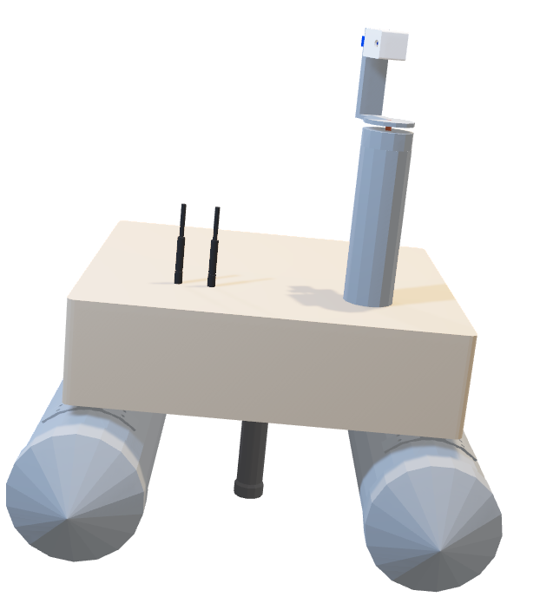
Thank You Q/A?

